Slide 1




Fund More & Earn More
Exclusive Partner Event:
The Funding
Revolution Begins…
Maximize Your Earnings with 20 New Funding Programs!
©️2025 Credit Suite, all rights reserved. No reproduction or use of any portion of the content or work or the entire work is permitted without the express written permission and authorization of the company.

Slide 2

The Economy is Changing
Economic uncertainty, market shifts, and changing consumer confidence are impacting sales across industries.
When consumers feel uncertain, they spend cautiously—
but they also seek financing options to prepare for
the unexpected
Now more than ever, business owners are actively searching
for capital
In fact, the demand for financing is at an all-time high
That’s the purpose of this exclusive partner event, to help you seize this opportunity, assist more clients in securing funding, and significantly boost your commissions
©️2025 Credit Suite, all rights reserved. No reproduction or use of any portion of the content or work or the entire work is permitted without the express written permission and authorization of the company.

Slide 3


Understanding the Surge in Business Funding Demand
©️2025 Credit Suite, all rights reserved. No reproduction or use of any portion of the content or work or the entire work is permitted without the express written permission and authorization of the company.

Slide 4
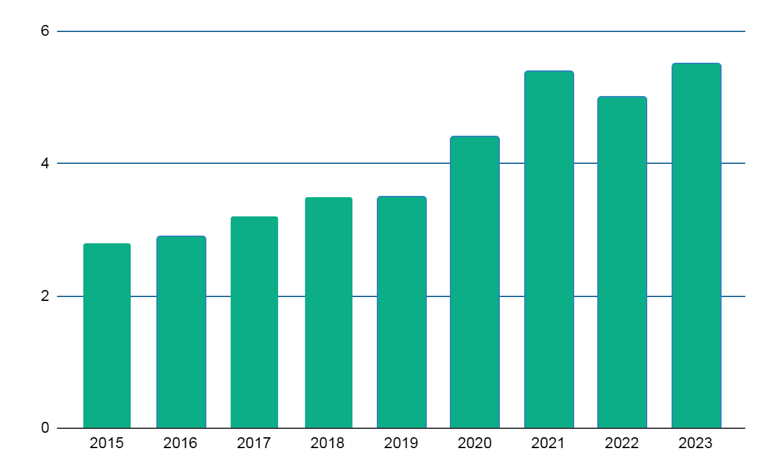
US total annual small business applications
5.4m
5.5m
5m
4.4m
3.5m
3.5m
3.2m
2.8m
2.9m
Year
©️2025 Credit Suite, all rights reserved. No reproduction or use of any portion of the content or work or the entire work is permitted without the express written permission and authorization of the company.

Slide 5
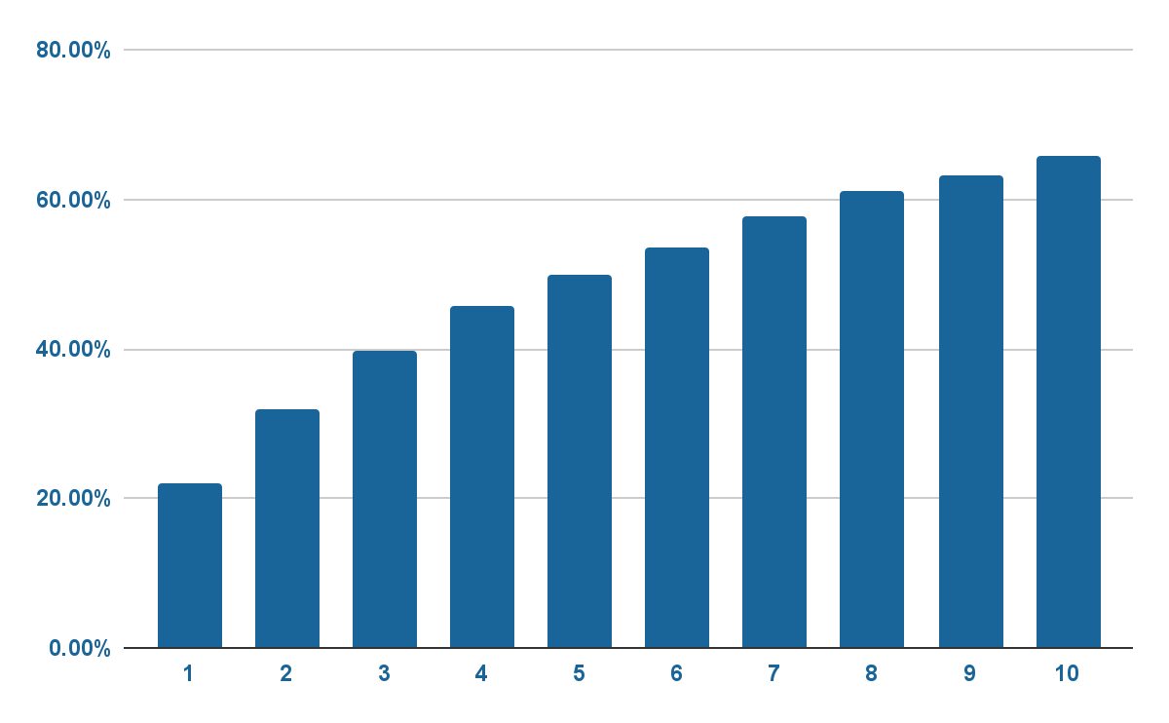
Small Business Failure Rate
5.4m
5.5m
63.2%
65.7%
57.7%
61%
5m
53.6%
50%
4.4m
% of Business That Fail
21.9%
45.7%
3.5m
31.8%
From Zippia
21.9%
3.5m
3.2m
Years in Business
2.8m
2.9m
©️2025 Credit Suite, all rights reserved. No reproduction or use of any portion of the content or work or the entire work is permitted without the express written permission and authorization of the company.

Slide 6
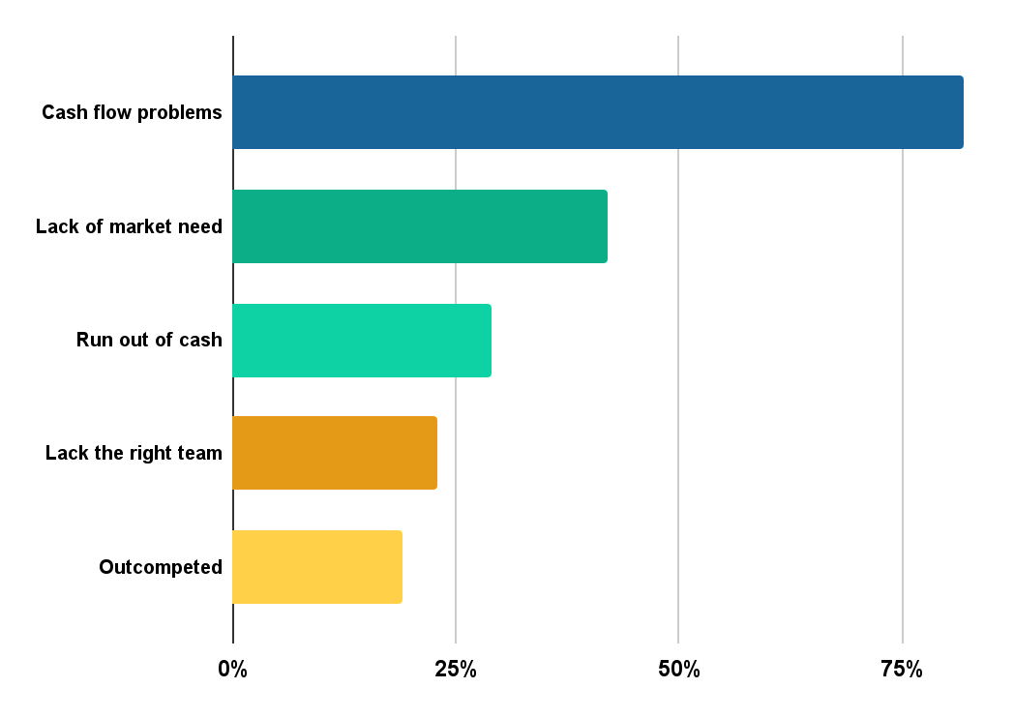
Why
Small Businesses Fail
82%
42%
5.4m
5.5m
5m
4.4m
29%
3.5m
3.5m
3.2m
2.8m
2.9m
23%
19%
From Zippia
©️2025 Credit Suite, all rights reserved. No reproduction or use of any portion of the content or work or the entire work is permitted without the express written permission and authorization of the company.

Slide 7
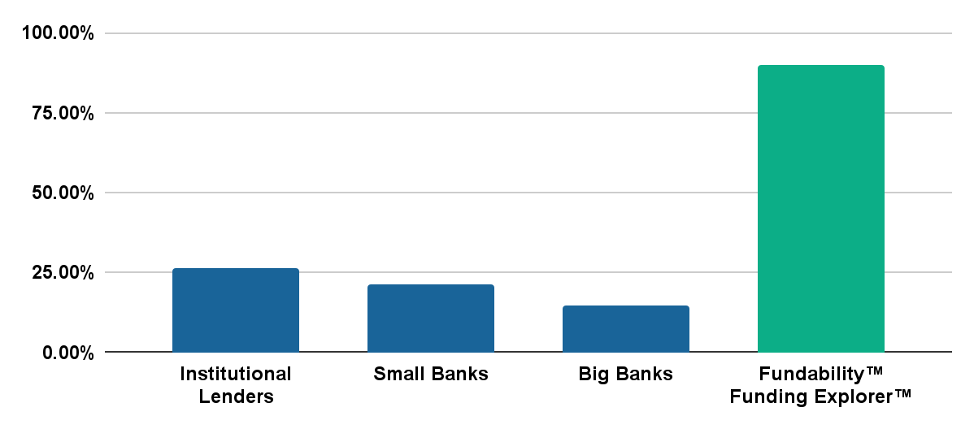
Loan Approval Rates at Traditional Banks - Jan 2023
90%+*
*
Hint: “How to look attractive to lenders before you apply”
Approval Rate (%)
26.1%
21.4%
14.4%
Lender Type
Note: With the Funding Explorer™ you can see all the lender criteria before you even apply.
Source: https://www.forbes.com/sites/rohitarora/2023/02/24/high-interest-rates-at-banks-make-alternative-lenders-more-attractive-for-small-business-borrowers/
©️2025 Credit Suite, all rights reserved. No reproduction or use of any portion of the content or work or the entire work is permitted without the express written permission and authorization of the company.

Slide 8





Why Business Owners Are Discouraged
From Applying for Financing
36%
Too much existing debt
44%
Weak sales
23%
New/insufficient credit history
33%
Low credit score
41%
Not enough collateral
Other
8%
% of discouraged nonapplicants
Respondents could select multiple options
Source: 2021 Federal Banks’ Small Business Credit others.
©️2025 Credit Suite, all rights reserved. No reproduction or use of any portion of the content or work or the entire work is permitted without the express written permission and authorization of the company.

Slide 9
SME Financing Gap
"In 2019, SMBs were unable to secure an estimated $3.4 trillion.”
FICO
*This figure has increased post-covid.
Source: https://www.fico.com/blogs/filling-us34-trillion-sme-funding-gap
©️2024 Credit Suite, all rights reserved. No reproduction or use of any portion of the content or work or the entire work is permitted without the express written permission and authorization of the company.

Slide 10
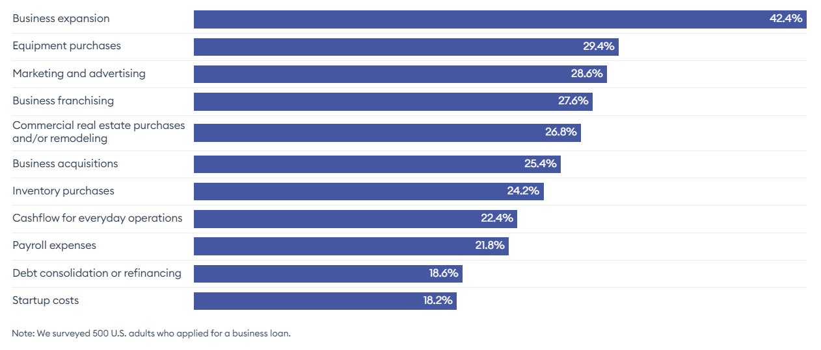
What Businesses Need Money For
Reasons for Applying for a Business Loan
Respondents were able to select up to three reasons why they applied for the icon.
5.5m
3.5m
3.5m
3.2m
2.9m
2.8m
Source: Forbes Advisor April 2023 Survey • Embed
Source: https://www.forbes.com/advisor/business-loans/small-business-loan-statistics/
©️2025 Credit Suite, all rights reserved. No reproduction or use of any portion of the content or work or the entire work is permitted without the express written permission and authorization of the company.

Slide 11

Understanding the
Solution to the Surge in Business Funding Demand
©️2025 Credit Suite, all rights reserved. No reproduction or use of any portion of the content or work or the entire work is permitted without the express written permission and authorization of the company.

Slide 12

The Solution to the
Funding Demand Surge
The number of new businesses is exponentially increasing, and so is their demand to obtain capital for survival
The answer to this demand is more ways for business owners to secure capital
… and to develop a funding blueprint plan to get capital NOW, while setting up the business longer-term to get optimal capital
©️2025 Credit Suite, all rights reserved. No reproduction or use of any portion of the content or work or the entire work is permitted without the express written permission and authorization of the company.

Slide 13

SmartFund Ai
We’ve long sought to offer all funding types
to borrowers
But, human capacity to remember all funding programs and qualifications has limited our ability to do it
Our brand new SmartFund AI fixes that
For the first time ever, there’s a now a solution for a customer to qualify for ALL funding programs in one place
Some we offer them direct, others we guide them direct to the source
©️2025 Credit Suite, all rights reserved. No reproduction or use of any portion of the content or work or the entire work is permitted without the express written permission and authorization of the company.

Slide 14

SmartFund Ai
This lets us now get more customers funded
And get even more financing for
those customers
Funding Stacking will get clients even
more funding
This applies to those looking for startup, and growth capital
And those looking for major expansion capital, acquisition capital to buy an existing business or franchise
©️2025 Credit Suite, all rights reserved. No reproduction or use of any portion of the content or work or the entire work is permitted without the express written permission and authorization of the company.

Slide 15

All Funding
In One Place
To get more funding for more customers, we need more funding programs
Here’s a look at our expanded funding arsenal:
©️2025 Credit Suite, all rights reserved. No reproduction or use of any portion of the content or work or the entire work is permitted without the express written permission and authorization of the company.

Slide 16

Credit Line Hybrid/
Business Credit Cards
Description: This program offers a revolving credit line through business credit cards, typically with a 0% APR for an introductory period, after which the rates increase based on creditworthiness.
©️2025 Credit Suite, all rights reserved. No reproduction or use of any portion of the content or work or the entire work is permitted without the express written permission and authorization of the company.

Slide 17
Line Amounts: $10,000-$150,000
Term: Revolving credit cards
Rates: 0% APR typically for 6-18 months, after that 5-29% APR, 9.9% success rate fee paid after funded
Collateral Required: Strong personal credit
Credit Requirements:
  Personal credit score 680+ on all 3 bureaus
  Under 40% utilization on each revolving accounts
  No more than 4 bank inquiries per bureau in the last 12 months (Does not include secured inquiries like auto loans and mortgages)
  No more than 3 unsecured accounts opened in past 12 months
  No bankruptcies at all
  No open/unpaid collections or judgments
  No late payments in 2 years and no charged off accounts
  Seasoned major bank card trade lines $5,000 limit +. Must have a minimum of 2 open revolving accounts with $5,000 limit +, with at least 2 years of
  history or more
©️2025 Credit Suite, all rights reserved. No reproduction or use of any portion of the content or work or the entire work is permitted without the express written permission and authorization of the company.

Slide 18

Term Loans
Description: This program offers loan approvals of up to $10 million, with terms ranging from 1 to 5 years, and monthly payments available. The loan is based on consistent business revenue, verifiable through business bank statements.
©️2025 Credit Suite, all rights reserved. No reproduction or use of any portion of the content or work or the entire work is permitted without the express written permission and authorization of the company.

Slide 19
Loan/ Line Amounts: Approvals up to $10 million
Term: 1-5 years, monthly payments available
Rates: Variable
Collateral Required: Consistent revenue verifiable through business bank statements
Credit Requirements: Personal credit score 650+
©️2025 Credit Suite, all rights reserved. No reproduction or use of any portion of the content or work or the entire work is permitted without the express written permission and authorization of the company.

Slide 20

Line of Credit
Description: This program offers revolving credit lines of up to $750,000, with simple interest rates and the ability to only pay on the amount drawn.
©️2025 Credit Suite, all rights reserved. No reproduction or use of any portion of the content or work or the entire work is permitted without the express written permission and authorization of the company.

Slide 21
Loan/ Line Amounts: Credit lines up to $750,000
Term: Revolving credit
Rates: Simple interest
Collateral Required: Consistent revenue verifiable through business bank statements
Credit Requirements: Personal credit score 600+
©️2025 Credit Suite, all rights reserved. No reproduction or use of any portion of the content or work or the entire work is permitted without the express written permission and authorization of the company.

Slide 22

Account Receivable Financing
Description: This program provides advances on account receivables, allowing businesses to access cash before customers pay their invoices, with no application fees and flexible terms.
©️2025 Credit Suite, all rights reserved. No reproduction or use of any portion of the content or work or the entire work is permitted without the express written permission and authorization of the company.

Slide 23
Loan/ Line Amounts: Up to $20 million
Term: Variable
Rates: Interest rates under 2%
Collateral Required: Account Receivables
Credit Requirements: Poor credit accepted
©️2025 Credit Suite, all rights reserved. No reproduction or use of any portion of the content or work or the entire work is permitted without the express written permission and authorization of the company.

Slide 24

Purchase Order Financing
Description: Purchase Order Financing program provides financing based on
existing purchase orders, with funds paid directly to the supplier to help businesses fulfill large orders.
©️2025 Credit Suite, all rights reserved. No reproduction or use of any portion of the content or work or the entire work is permitted without the express written permission and authorization of the company.

Slide 25
Loan/ Line Amounts: Up to $20 million
Term: Variable
Rates: 2% – 5%
Collateral Required: Purchase Orders
Credit Requirements: None
©️2025 Credit Suite, all rights reserved. No reproduction or use of any portion of the content or work or the entire work is permitted without the express written permission and authorization of the company.

Slide 26

Equipment Financing
Description: Equipment Financing program offers financing for purchasing equipment, with loan amounts up to $5 million and flexible terms, including special conditions for long haul trucking.
©️2025 Credit Suite, all rights reserved. No reproduction or use of any portion of the content or work or the entire work is permitted without the express written permission and authorization of the company.

Slide 27
Loan/ Line Amounts: Up to $5 million
Term: 24-72 months
Rates: 6.25% – 25%
Collateral Required: Equipment purchased
Credit Requirements: Personal credit score 500+
©️2025 Credit Suite, all rights reserved. No reproduction or use of any portion of the content or work or the entire work is permitted without the express written permission and authorization of the company.

Slide 28

Sale-Leaseback Financing
Description: This program offers financing for titled equipment with loan amounts based on the equipment's value, and flexible terms of 2 to 6 years.
©️2025 Credit Suite, all rights reserved. No reproduction or use of any portion of the content or work or the entire work is permitted without the express written permission and authorization of the company.

Slide 29
Loan/ Line Amounts: Equipment value of $400,00.00 or greater
Term: 2 years – 6 years
Rates: None
Collateral Required: Titled equipment
Credit Requirements: Personal credit score 550+
©️2025 Credit Suite, all rights reserved. No reproduction or use of any portion of the content or work or the entire work is permitted without the express written permission and authorization of the company.

Slide 30

Equipment Leasing
Description: Equipment Leasing allows businesses to acquire equipment without the high upfront costs. Rather than buying equipment outright, businesses can lease it for a specified period, with an option to purchase, renew, or return the equipment at the end of the lease term. This option provides flexibility, preserves cash flow, and helps businesses keep up with the latest technology without the risk of obsolescence.
©️2025 Credit Suite, all rights reserved. No reproduction or use of any portion of the content or work or the entire work is permitted without the express written permission and authorization of the company.

Slide 31
Loan/ Line Amounts: $1,000 - $250,000
Terms: 12 months - 5 years
Rates: 5% - 22%
Collateral Required: Equipment being leased
Credit Requirements: Minimum 600+ personal credit score
©️2025 Credit Suite, all rights reserved. No reproduction or use of any portion of the content or work or the entire work is permitted without the express written permission and authorization of the company.

Slide 32

NEW Equipment Line of Credit
Description: An Equipment Line of Credit provides businesses with flexible access to capital specifically for purchasing equipment or managing equipment-related expenses. Unlike traditional loans, a line of credit allows businesses to draw funds as needed, up to the approved credit limit. This makes it ideal for companies that need to purchase multiple pieces of equipment or want the flexibility to finance equipment on an ongoing basis as their business grows. Repayments can be made as funds are used, with interest charged only on the amount borrowed.
©️2025 Credit Suite, all rights reserved. No reproduction or use of any portion of the content or work or the entire work is permitted without the express written permission and authorization of the company.

Slide 33
Loan/ Line Amounts: $10,000 to $100 million+
Terms: Up to 3 years
Rates: 0.50% - 9%
Collateral Required: Secured by business assets, including accounts receivable, inventory, and equipment.
-
Secured by the equipment being financed.
-
Business Lines of Credit: Unsecured up to certain limits; higher amounts may
require collateral.
-
Secured by non-real estate business assets, such as equipment or inventory. PNC.COM
-
Business Lines of Credit: Unsecured up to certain limits; higher amounts may
require collateral.
Credit Requirements: 650 - 700
©️2025 Credit Suite, all rights reserved. No reproduction or use of any portion of the content or work or the entire work is permitted without the express written permission and authorization of the company.

Slide 34

Retirement Account Financing
Description: This program allows you to borrow up to 100% of your "rollable" retirement account value, such as a 401K or IRA, with no credit requirements.
©️2025 Credit Suite, all rights reserved. No reproduction or use of any portion of the content or work or the entire work is permitted without the express written permission and authorization of the company.

Slide 35
Loan/ Line Amounts: Up to 100% of current retirement account value that’s “rollable”
Term: 5 years, if applicable
Rates: Prime + 2 and fees – $3500 to $5000
Collateral Required: 401K or IRA
Credit Requirements: None
©️2025 Credit Suite, all rights reserved. No reproduction or use of any portion of the content or work or the entire work is permitted without the express written permission and authorization of the company.

Slide 36

SBA
Description: This program offers SBA-backed loans for businesses, with funding amounts up to $5 million, flexible terms, and specific requirements for business profitability and personal credit.
©️2025 Credit Suite, all rights reserved. No reproduction or use of any portion of the content or work or the entire work is permitted without the express written permission and authorization of the company.

Slide 37
Loan/ Line Amounts: Up to $5 million
Term: 10 to 25 years
Rates: Prime + 1% – 2.75%
Collateral Required: Revenue from Business and Personal Financials
Credit Requirements: Personal credit score 650+
©️2025 Credit Suite, all rights reserved. No reproduction or use of any portion of the content or work or the entire work is permitted without the express written permission and authorization of the company.

Slide 38

Real Estate
Description: This program offers loans for commercial real estate, including fix-and-flip, multi-family, and new construction projects. The program is designed for business owners or investors with equity in commercial properties.
©️2025 Credit Suite, all rights reserved. No reproduction or use of any portion of the content or work or the entire work is permitted without the express written permission and authorization of the company.

Slide 39
Loan/ Line Amounts: $50,000-$10 million
Term: 12 months up to 30 years depending on program
Rates: 7.99% and up
Collateral Required: Commercial Real Estate
Credit Requirements: Personal credit score 650+
©️2025 Credit Suite, all rights reserved. No reproduction or use of any portion of the content or work or the entire work is permitted without the express written permission and authorization of the company.

Slide 40

Book of Business Financing
– Insurance Business
Description: This program offers financing for insurance businesses based on their book of business, including options for acquisition, working capital, or business debt restructuring.
©️2025 Credit Suite, all rights reserved. No reproduction or use of any portion of the content or work or the entire work is permitted without the express written permission and authorization of the company.

Slide 41
Loan/ Line Amounts: $50,000-$50 million
Term: Up to 12 years
Rated: Variable
Collateral Required: Book of Business Report – Rolling 12 month breakdown commission by carrier
Credit Requirements: None
©️2025 Credit Suite, all rights reserved. No reproduction or use of any portion of the content or work or the entire work is permitted without the express written permission and authorization of the company.

Slide 42

Personal Loans
Description: Personal loans provide individuals with flexible funding options, ranging from small to large amounts, for various purposes such as debt consolidation, home improvement, or emergency needs.
©️2025 Credit Suite, all rights reserved. No reproduction or use of any portion of the content or work or the entire work is permitted without the express written permission and authorization of the company.

Slide 43
Loan/ Line Amounts: $250 - $500,000
Term: 6 months - 84 months, 3% - 35.99%
Rated: 0.01% – 35.99%
Collateral Required: None
Credit Requirements: 510 to 690850
©️2025 Credit Suite, all rights reserved. No reproduction or use of any portion of the content or work or the entire work is permitted without the express written permission and authorization of the company.

Slide 44

Personal loans Sub Prime
Description: This loan program is designed for individuals who may have a lower credit score (typically below 640), making them ineligible for prime loan options. The loans can be used for a variety of personal expenses, including debt consolidation, medical bills, home improvements, or emergencies. These loans typically come with higher interest rates to offset the increased risk to the lender.
©️2025 Credit Suite, all rights reserved. No reproduction or use of any portion of the content or work or the entire work is permitted without the express written permission and authorization of the company.

Slide 45
Loan/ Line Amounts: $500 - $25,000
Terms: 1 to 5 years
Rates: 24% - 36% (Can vary depending on the lender and the
borrower's creditworthiness)
Collateral Required: None
Credit Requirements: Minimum credit score of 500-640
©️2025 Credit Suite, all rights reserved. No reproduction or use of any portion of the content or work or the entire work is permitted without the express written permission and authorization of the company.

Slide 46

Personal Loan Stacking
Description: This program is designed for individuals who seek to access larger sums of money by stacking multiple personal loans from different lenders or financial institutions. The purpose of this method is to allow borrowers to secure more funds than they might be able to obtain from a single loan. While this can offer more flexibility, it also carries increased risks such as managing multiple repayments, higher interest rates, and a potential negative impact on credit scores.
©️2025 Credit Suite, all rights reserved. No reproduction or use of any portion of the content or work or the entire work is permitted without the express written permission and authorization of the company.

Slide 47
Loan/ Line Amounts: $1,000 - $50,000+
Terms: 1 to 5 years
Rates: 6% - 36%
Collateral Required: "Unsecured Loans: No collateral is required for most personal loan stacking programs, as these are typically unsecured loans.
-
Secured Loan Options: In some cases, lenders may offer secured loans with lower rates, but this would require collateral (e.g., home, car)."
Credit Requirements: 500 - 700
©️2025 Credit Suite, all rights reserved. No reproduction or use of any portion of the content or work or the entire work is permitted without the express written permission and authorization of the company.

Slide 48

Microloans
Description: Microloans offer small loans to individuals or businesses, often aimed at helping startups, small businesses, or personal financial needs.
©️2025 Credit Suite, all rights reserved. No reproduction or use of any portion of the content or work or the entire work is permitted without the express written permission and authorization of the company.

Slide 49
Loan/ Line Amounts: $25 - $150,000
Term: 6 - 60 months, 0% - 39%
Rated: 0% - 39%
Collateral Required: None
Credit Requirements: 550 to 800
©️2025 Credit Suite, all rights reserved. No reproduction or use of any portion of the content or work or the entire work is permitted without the express written permission and authorization of the company.

Slide 50

Securities Financing
Description: Securities Financing allows clients to borrow funds by leveraging their non-retirement, marketable securities as collateral. This type of loan is ideal for clients looking to access liquidity without having to liquidate their investments. The program offers flexibility in loan amounts, terms, and uses high-quality collateral to secure the loan, ensuring minimal risk for both parties.
©️2025 Credit Suite, all rights reserved. No reproduction or use of any portion of the content or work or the entire work is permitted without the express written permission and authorization of the company.

Slide 51
Loan/ Line Amounts: $75,000 to $25 million, with advances starting at $2,500
Terms: Vary
Rates: 0.10% to 5%
Collateral Required: "Eligible collateral includes non-retirement, marketable securities. Chase Bank assigns values to these securities and may adjust their eligibility as collateral without notice.
-
Schwab posts cash collateral equal to the full market value of the securities on loan, ensuring protection in case of Schwab's failure.
-
Loans are secured with high-quality collateral, and Northern Trust actively manages collateral to optimize returns while mitigating risk.
-
Non-retirement investment assets, including stocks, bonds, mutual funds, and ETFs."
Credit Requirements: 650+
©️2025 Credit Suite, all rights reserved. No reproduction or use of any portion of the content or work or the entire work is permitted without the express written permission and authorization of the company.

Slide 52

ROBS
Description: ROBS allows individuals to use their retirement savings (such as 401(k) or IRA) to fund a new business or franchise without incurring penalties or taxes. This financing option is ideal for those who have a substantial amount in their retirement accounts and want to use those funds to invest in their business without taking out a traditional loan.
©️2025 Credit Suite, all rights reserved. No reproduction or use of any portion of the content or work or the entire work is permitted without the express written permission and authorization of the company.

Slide 53
Loan/ Line Amounts: $50,000 to $5 million
Terms: 5 to 10 years
Rates: 5% to 8%
Collateral Required: None
Credit Requirements: 650+
©️2025 Credit Suite, all rights reserved. No reproduction or use of any portion of the content or work or the entire work is permitted without the express written permission and authorization of the company.

Slide 54

NEW Crypto Financing
Description: Crypto Financing allows individuals or institutional investors to access liquidity by using cryptocurrencies as collateral. This type of loan is designed for those who wish to leverage their cryptocurrency holdings without the need to sell them. By offering crypto-backed loans, clients can retain their crypto assets while gaining access to immediate funds for other investment opportunities, debt repayment, or other personal or business needs.
©️2025 Credit Suite, all rights reserved. No reproduction or use of any portion of the content or work or the entire work is permitted without the express written permission and authorization of the company.

Slide 55
Loan/ Line Amounts: $50 to $2 million
Terms: 1 week to 2 years
Rates: 0% to 13.9%
Collateral Required: “Accepted collateral includes various cryptocurrencies like Bitcoin (BTC), Ethereum (ETH), and others. Each has its own LTV ratio.
-
Accepted collateral includes Bitcoin (BTC), Ethereum (ETH), and Solana (SOL). Each cryptocurrency has its own LTV thresholds and margin call limits.
-
Accepted collateral includes mainstream cryptocurrencies like Bitcoin, Ethereum, Litecoin, and Cardano. The specific cryptocurrencies accepted can vary by lender
-
Loans require BTC or ETH as collateral, with a loan-to-value (LTV) ratio of 50%."
Credit Requirements:
Typically not required as loans are secured by the value of the cryptocurrency
being pledged.
-
However, lenders may assess overall financial health (income, other assets, or existing debts) as part of the application process, especially for larger loan amounts.
©️2025 Credit Suite, all rights reserved. No reproduction or use of any portion of the content or work or the entire work is permitted without the express written permission and authorization of the company.

Slide 56

Inventory Financing
Description: Inventory Financing provides businesses with the capital they need by leveraging existing inventory as collateral. This type of loan is ideal for businesses that need quick access to cash but do not want to sell their inventory. The loan can help with purchasing more inventory, managing operational expenses, or bridging short-term cash flow gaps. By using inventory as collateral, businesses can unlock liquidity without sacrificing their assets.
©️2025 Credit Suite, all rights reserved. No reproduction or use of any portion of the content or work or the entire work is permitted without the express written permission and authorization of the company.

Slide 57
Loan/ Line Amounts: up to $400,000
Terms: 6 or 12 months
Rates: 5% - 20%
Collateral Required: Inventory financed typically serves as collateral for the loan.
-
Inventory financing typically requires using existing inventory as collateral. CIT Group provides asset-based lending solutions that leverage accounts receivable, inventory, or fixed assets as collateral.
Credit Requirements: 550- 625
©️2025 Credit Suite, all rights reserved. No reproduction or use of any portion of the content or work or the entire work is permitted without the express written permission and authorization of the company.

Slide 58

NEW Commercial Truck Loans
Description: Commercial Truck Loans are specifically designed to help businesses finance the purchase or lease of commercial vehicles, such as trucks, vans, or specialized vehicles. These loans enable businesses in industries like transportation, logistics, or construction to acquire vehicles necessary for operations. The loan is typically secured by the financed vehicle, ensuring that the lender has collateral in case of default.
©️2025 Credit Suite, all rights reserved. No reproduction or use of any portion of the content or work or the entire work is permitted without the express written permission and authorization of the company.

Slide 59
Loan/ Line Amounts: $10,000 to $1,000,000
Terms: 24 to 60 months
Rates: 6.19% - 8.25%
Collateral Required: QuickBridge offers both secured and unsecured loans; the requirement for collateral depends on the loan product and applicant qualifications
Credit Requirements: 600 - 675
©️2025 Credit Suite, all rights reserved. No reproduction or use of any portion of the content or work or the entire work is permitted without the express written permission and authorization of the company.

Slide 60

Fix and Flip Financing
Description: Fix and Flip Financing is a short-term loan designed specifically for real estate investors who purchase properties to renovate and resell at a profit. These loans are typically used for residential properties that need repairs or upgrades before being resold. The financing covers the purchase price and renovation costs, and is paid back after the property is sold or refinanced.
©️2025 Credit Suite, all rights reserved. No reproduction or use of any portion of the content or work or the entire work is permitted without the express written permission and authorization of the company.

Slide 61
Loan/ Line Amounts: $75,000 - $5,000,000
Terms: 12 months - 24 months
Rates: 7% - 12.99%
Collateral Required: Property being flipped (Real Estate)
Credit Requirements: Minimum 600+ credit score
©️2025 Credit Suite, all rights reserved. No reproduction or use of any portion of the content or work or the entire work is permitted without the express written permission and authorization of the company.

Slide 62

NEW DSCR Loans
Description: Debt Service Coverage Ratio (DSCR) Loans are a type of real estate financing that evaluates a borrower's ability to repay a loan based on the income the property generates. DSCR is a key financial ratio used by lenders to assess the risk associated with a loan, particularly in investment properties. It is a measure of a property’s ability to cover its debt obligations using its operating income. These loans are commonly used for commercial real estate, rental properties, and multi-family units.
©️2025 Credit Suite, all rights reserved. No reproduction or use of any portion of the content or work or the entire work is permitted without the express written permission and authorization of the company.

Slide 63
Loan/ Line Amounts: $75,000 - $5,000,000
Terms: 12 months - 24 months
Rates: 7% - 12.99%
Collateral Required: Property being flipped (Real Estate)
Credit Requirements: Minimum 600+ credit score
©️2025 Credit Suite, all rights reserved. No reproduction or use of any portion of the content or work or the entire work is permitted without the express written permission and authorization of the company.

Slide 64

NEW Portfolio Loans
Description: A Portfolio Loan is a type of loan that is underwritten and held in-house by the lender, typically a bank or credit union, rather than being sold on the secondary mortgage market (like Fannie Mae or Freddie Mac). These loans are ideal for borrowers whose financial situation doesn’t meet the rigid requirements of traditional loans. A portfolio loan can be used for a variety of purposes, such as purchasing real estate, refinancing properties, or consolidating debt, and is often offered to individuals with unique financial circumstances.
©️2025 Credit Suite, all rights reserved. No reproduction or use of any portion of the content or work or the entire work is permitted without the express written permission and authorization of the company.

Slide 65
Loan/ Line Amounts: $50,000 to $10 million
Terms: 12 months to 30 years
Rates: Typically 4% to 12%
Collateral Required: Typically, real estate properties or investment assets serve as collateral. The loan amount is often determined based on the value of the portfolio being financed.
Credit Requirements: Credit score of 620+
©️2025 Credit Suite, all rights reserved. No reproduction or use of any portion of the content or work or the entire work is permitted without the express written permission and authorization of the company.

Slide 66

SBA 504 Loans
Description: SBA 504 Loans are long-term, fixed-rate financing options provided by the Small Business Administration (SBA) to help small businesses purchase real estate, machinery, and equipment. The SBA 504 program is designed for businesses that are looking to expand or acquire large fixed assets, such as commercial real estate or heavy equipment, without putting too much strain on their cash flow. It offers lower down payments compared to conventional loans and more favorable interest rates.
©️2025 Credit Suite, all rights reserved. No reproduction or use of any portion of the content or work or the entire work is permitted without the express written permission and authorization of the company.

Slide 67
Loan/ Line Amounts: Up to $5 million
Terms: 10, 20, or 25 years
Rates: 3% - 6% (fixed rates for 10-25 years)
Collateral Required: Real estate or equipment being financed, personal guarantee
Credit Requirements: Typically a 650+ credit score
©️2025 Credit Suite, all rights reserved. No reproduction or use of any portion of the content or work or the entire work is permitted without the express written permission and authorization of the company.

Slide 68

NEW IP-Backed Loans
Description: IP-Backed Loans are a type of financing that allows companies to leverage their intellectual property (IP), such as patents, trademarks, copyrights, and trade secrets, as collateral. These loans are ideal for businesses with valuable IP assets but limited physical or cash collateral. IP-backed loans are often used for research and development, expansion, working capital, or strategic acquisitions, enabling companies to unlock capital tied up in their intellectual assets.
©️2025 Credit Suite, all rights reserved. No reproduction or use of any portion of the content or work or the entire work is permitted without the express written permission and authorization of the company.

Slide 69
Loan/ Line Amounts: $1,000,000 to $50,000,000
Terms: 3 to 10 years
Rates: 8% -15%
Collateral Required: The primary collateral is the company's IP assets. Aon utilizes Collateral Protection Insurance (CPI) to insure the IP's value, covering up to 90-100% of the principal loan amount.
-
The primary collateral comprises the company's IP assets, with loans secured against up to 50% of their assessed value. NATWEST GROUP.
-
The primary collateral comprises the company's IP assets, including patents, trademarks, copyrights, trade secrets, and contract rights. RANDOLPHSQUAREIP.COM
Credit Requirements: 650+
©️2025 Credit Suite, all rights reserved. No reproduction or use of any portion of the content or work or the entire work is permitted without the express written permission and authorization of the company.

Slide 70

NEW Patent Financing
Description: Patent Financing provides businesses with capital by using their patents as collateral. This type of financing allows companies to leverage their intellectual property (IP) assets to secure funding for growth, R&D, or other business needs. It’s especially useful for businesses in tech, pharmaceuticals, and other innovation-driven industries.
©️2025 Credit Suite, all rights reserved. No reproduction or use of any portion of the content or work or the entire work is permitted without the express written permission and authorization of the company.

Slide 71
Loan/ Line Amounts: $2 million to $60 million
Terms: 3 to 10 years
Rates: 9-12%
Collateral Required: The primary collateral comprises the company's patents
Credit Requirements: 650+
©️2025 Credit Suite, all rights reserved. No reproduction or use of any portion of the content or work or the entire work is permitted without the express written permission and authorization of the company.

Slide 72

NEW CD-Backed Loan
Description: A CD-Backed Loan (Certificate of Deposit-Backed Loan) is a type of secured loan where a borrower pledges a Certificate of Deposit (CD) as collateral in exchange for a loan from a financial institution. The borrower can access funds without cashing in their CD, and the CD continues to earn interest while serving as collateral. This type of loan is often used by individuals or businesses who wish to unlock liquidity from their CDs without losing the interest income.
©️2025 Credit Suite, all rights reserved. No reproduction or use of any portion of the content or work or the entire work is permitted without the express written permission and authorization of the company.

Slide 73
Loan/ Line Amounts: Typically up to 100% of the CD value
Terms: 1 to 5 years
Rates: 2% to 6%
Collateral Required: None
Credit Requirements: A minimum 600-650 credit score is often required
©️2025 Credit Suite, all rights reserved. No reproduction or use of any portion of the content or work or the entire work is permitted without the express written permission and authorization of the company.

Slide 74

NEW Leasehold Financing
Description: Leasehold Financing allows businesses to secure loans using the leasehold interest in a property as collateral, where the property is located on leased land. This type of financing is ideal for borrowers looking to finance improvements or leverage a lease agreement that generates income.
©️2025 Credit Suite, all rights reserved. No reproduction or use of any portion of the content or work or the entire work is permitted without the express written permission and authorization of the company.

Slide 75
Loan/ Line Amounts: up to $2,000,000
Terms: 5 to 30 years
Rates: 5% - 15%
Collateral Required: "The property situated on leased land serves as collateral
for the loan.
-
The leasehold interest in the property serves as collateral for the loan.
-
Typically secured by the leasehold improvements financed by the loan.
-
The primary collateral is the lease agreement and the income stream it generates, rather than the physical property itself."
Credit Requirements: 650
©️2025 Credit Suite, all rights reserved. No reproduction or use of any portion of the content or work or the entire work is permitted without the express written permission and authorization of the company.

Slide 76

NEW Intangible Asset Financing
Description: Intangible Asset Financing allows businesses to secure loans by leveraging luxury assets (like fine art, classic cars, jewelry, watches, and collectibles) or intangible assets (such as patents, trademarks, and other intellectual property). This financing is ideal for companies or individuals looking to unlock the value of assets that aren't physical property but still hold significant worth.
©️2025 Credit Suite, all rights reserved. No reproduction or use of any portion of the content or work or the entire work is permitted without the express written permission and authorization of the company.

Slide 77
Loan/ Line Amounts: $2,500 to $5,000,000
Terms: 1 to 24 months
Rates: 8% - 20%
Collateral Required: "Loans are secured by luxury assets, including fine art, classic cars, jewelry, watches, and other collectibles. BORRO.COM
-
Intangible assets, such as patents or trademarks, may need to be independently valued to serve as collateral. RANGEWELL.COM
-
Valuation of both tangible and intangible assets to serve as collateral.
-
Valuation of assets, including intangible assets, to serve as collateral.
-
In ABF transactions, financing is secured by valuable and often highly diversified pools of assets. APOLLO.COM
-
In asset-backed financing transactions, financing is secured by valuable and often highly diversified pools of assets.
-
In ABF transactions, financing is secured by valuable and often highly diversified pools of assets."
Credit Requirements: 650+
©️2025 Credit Suite, all rights reserved. No reproduction or use of any portion of the content or work or the entire work is permitted without the express written permission and authorization of the company.

Slide 78

NEW Customer List Monetization Loans
Description: Customer List Monetization Loans allow businesses to leverage their customer database or customer lists as a form of collateral for financing. The loan is based on the future value of the business's customer base, making it ideal for companies with a large, engaged customer list that can be monetized for future sales.
©️2025 Credit Suite, all rights reserved. No reproduction or use of any portion of the content or work or the entire work is permitted without the express written permission and authorization of the company.

Slide 79
Loan/ Line Amounts: $10,000 to $20 million
Terms: 3 years+
Rates: 5-10%
Collateral Required: None
Credit Requirements: 650+
©️2025 Credit Suite, all rights reserved. No reproduction or use of any portion of the content or work or the entire work is permitted without the express written permission and authorization of the company.

Slide 80

NEW Government Contract Financing
Description: Government Contract Financing provides working capital for businesses that have secured government contracts. The financing is typically based on the accounts receivable from those contracts and helps businesses manage cash flow while waiting for payments from government entities.
©️2025 Credit Suite, all rights reserved. No reproduction or use of any portion of the content or work or the entire work is permitted without the express written permission and authorization of the company.

Slide 81
Loan/ Line Amounts: $250,000 to $5 million
Terms: 6 months to 3 years
Rates: 6% to 15%
Collateral Required: "Collateral requirements are determined by the lender. While loans up to $25,000 may not require collateral, loans over $350,000 must be collateralized to the maximum extent possible.
-
Collateral requirements are evaluated on a case-by-case basis, considering the loan amount and the business's financial standing.
-
The primary collateral is typically the accounts receivable from the
government contracts.
-
May be required, depending on the loan type and amount.
-
Depending on the loan type and amount, collateral may be required."
Credit Requirements: 650+
©️2025 Credit Suite, all rights reserved. No reproduction or use of any portion of the content or work or the entire work is permitted without the express written permission and authorization of the company.

Slide 82

NEW License-Backed Business Loans
Description: License-Backed Business Loans allow businesses to leverage their licenses (such as business, software, or franchise licenses) as collateral for funding. These loans provide working capital or growth capital by monetizing the value of the business’s intellectual property or licenses, helping businesses expand or improve operations.
©️2025 Credit Suite, all rights reserved. No reproduction or use of any portion of the content or work or the entire work is permitted without the express written permission and authorization of the company.

Slide 83
Loan/ Line Amounts: $20,000 to $10 million
Terms: Up to 25 years
Rates: 8% - 20%
Collateral Required: "Both secured and unsecured loans are available. Secured loans may require collateral such as non-real estate assets. MTB.COM
-
Collateral requirements vary by loan product and borrower qualifications.
-
Some loans may require collateral to secure the funding."
Credit Requirements: 650+
©️2025 Credit Suite, all rights reserved. No reproduction or use of any portion of the content or work or the entire work is permitted without the express written permission and authorization of the company.

Slide 84

NEW Credit Union and Bank Signature Loans
Description: A Signature Loan is an unsecured loan offered by banks and credit unions, where the borrower agrees to repay the loan based solely on their signature (i.e., the promise to repay). Since the loan is unsecured, no collateral is required. These loans are ideal for individuals who need a lump sum of money for personal use, such as debt consolidation, emergency expenses, home improvements, or other personal needs.
©️2025 Credit Suite, all rights reserved. No reproduction or use of any portion of the content or work or the entire work is permitted without the express written permission and authorization of the company.

Slide 85
Loan/ Line Amounts: $1,000 - $50,000
Terms: 1 - 5 years
Rates: 6.50% - 24.99%
Collateral Required: None (unsecured loan)
Credit Requirements: 600+
©️2025 Credit Suite, all rights reserved. No reproduction or use of any portion of the content or work or the entire work is permitted without the express written permission and authorization of the company.

Slide 86

Revenue Lending
Description: Revenue Lending is a financing option for businesses that want to borrow money based on their monthly revenue, rather than their credit score or traditional collateral. It’s ideal for companies with consistent cash flow but less-than-ideal credit scores. The loan is repaid through a percentage of daily revenue.
©️2025 Credit Suite, all rights reserved. No reproduction or use of any portion of the content or work or the entire work is permitted without the express written permission and authorization of the company.

Slide 87
Loan/ Line Amounts: 5000 - $5 Million
Terms: 3-36 months
Rates: 1.09% - 1.55%
Collateral Required: None
Credit Requirements: 500+
©️2025 Credit Suite, all rights reserved. No reproduction or use of any portion of the content or work or the entire work is permitted without the express written permission and authorization of the company.

Slide 88

Merchant Cash Advances
Description: Merchant Cash Advances provide businesses with quick access to funds based on their daily credit card sales or revenue. This is not a loan in the traditional sense, but an advance on future sales. Repayment is made through a percentage of the business's daily credit card receipts or revenue. MCAs are ideal for businesses that need fast access to capital and have a steady flow of credit card transaction.
©️2025 Credit Suite, all rights reserved. No reproduction or use of any portion of the content or work or the entire work is permitted without the express written permission and authorization of the company.

Slide 89
Loan/ Line Amounts: 5K-5M
Terms: 3-36 months
Rates: 1.09 to 1.55
Collateral Required: None
Credit Requirements: Any credit
©️2025 Credit Suite, all rights reserved. No reproduction or use of any portion of the content or work or the entire work is permitted without the express written permission and authorization of the company.

Slide 90

Business Lines of Credit
Description: A Business Line of Credit (LOC) provides a flexible financing option that allows businesses to access funds up to a certain credit limit. Unlike a traditional loan, businesses only pay interest on the amount they borrow, rather than the full credit limit. This revolving credit facility helps businesses manage cash flow gaps, finance short-term needs, and cover unexpected expenses.
©️2025 Credit Suite, all rights reserved. No reproduction or use of any portion of the content or work or the entire work is permitted without the express written permission and authorization of the company.

Slide 91
Loan/ Line Amounts: $100,000
Terms: 6-12 months
Rates: 10% - 78%
Collateral Required: None
Credit Requirements: 600+
©️2025 Credit Suite, all rights reserved. No reproduction or use of any portion of the content or work or the entire work is permitted without the express written permission and authorization of the company.

Slide 92

Invoice Factoring
Description: Invoice Factoring allows businesses to sell their outstanding invoices to a lender or factoring company in exchange for immediate funding. This provides businesses with quick access to capital, helping them manage cash flow while waiting for customer payments.
©️2025 Credit Suite, all rights reserved. No reproduction or use of any portion of the content or work or the entire work is permitted without the express written permission and authorization of the company.

Slide 93
Loan/ Line Amounts: $20,000 to $5M
Terms: 1 to 24 weeks
Rates: 1%-4%
Collateral Required: "The factored invoices themselves serve as collateral. BLUEVINE.COM
-
Fundbox's advances are secured by your outstanding invoices. FUNDBOX.COM
-
The factored invoices themselves serve as collateral for the funding provided. ECAPITAL.COM"
-
“The factored invoices themselves serve as collateral for the funding provided."
Credit Requirements: 530
©️2025 Credit Suite, all rights reserved. No reproduction or use of any portion of the content or work or the entire work is permitted without the express written permission and authorization of the company.

Slide 94

SBA Loans
Description: SBA Loans are government-backed loans designed to help small businesses secure funding with favorable terms. These loans provide capital for business growth, working capital, and other financial needs while offering lower down payments and longer repayment periods compared to traditional loans.
©️2025 Credit Suite, all rights reserved. No reproduction or use of any portion of the content or work or the entire work is permitted without the express written permission and authorization of the company.

Slide 95
Loan/ Line Amounts: Up to $5 million
Terms: 10 years to 25 years
Rates: 5% - 10%
Collateral Required: Loans over $350,000 generally require collateral.
Credit Requirements: 650+
©️2025 Credit Suite, all rights reserved. No reproduction or use of any portion of the content or work or the entire work is permitted without the express written permission and authorization of the company.

Slide 96

SBA Credit Lines
Description: SBA Credit Lines provide businesses with flexible access to working capital. These lines of credit are supported by the SBA (Small Business Administration), which helps reduce the risk for lenders, offering competitive rates and longer repayment terms for qualified businesses. Funds can be used for various purposes, including inventory, accounts receivable, and general working capital.
©️2025 Credit Suite, all rights reserved. No reproduction or use of any portion of the content or work or the entire work is permitted without the express written permission and authorization of the company.

Slide 97
Loan/ Line Amounts: Up to $5 million
Terms: 12 months to 25 years
Rates: 7% - 10%
Collateral Required: Advance rates can be as high as 80% on eligible accounts receivables and 50% on eligible inventory. WWW-A.REGIONS.COM
-CAPLines can be administered on an asset-based structure or used to finance individual purchase orders or invoices. Proceeds can be used for financing suppliers, inventory, work-in-progress, or production of export goods or services. FIRSTAMBANK.COM
Collateral requirements may vary; for loans under $500,000, the SBA has relaxed collateral requirements.-
RESOURCES.LIVEOAK.BANK-
Secured lines require collateral, such as a blanket lien on assets or a Bank of America certificate of deposit. BUSINESS.BANKOFAMERICA.COM
Credit Requirements: 680-700
©️2025 Credit Suite, all rights reserved. No reproduction or use of any portion of the content or work or the entire work is permitted without the express written permission and authorization of the company.

Slide 98

NEW SBA Acquisition Financing
Description: SBA Acquisition Financing is designed to help businesses acquire other companies, real estate, or assets with government-backed loans. These loans offer favorable terms and lower down payments compared to traditional financing, making it an ideal option for small businesses looking to expand through acquisitions.
©️2025 Credit Suite, all rights reserved. No reproduction or use of any portion of the content or work or the entire work is permitted without the express written permission and authorization of the company.

Slide 99
Loan/ Line Amounts: $1,000 to $15 million
Terms: 5 to 25 years
Rates: 6% - 8%
Collateral Required: While collateral requirements are more flexible compared to conventional loans, some form of collateral may still be necessary. RESOURCES.LIVEOAK.BANK
Collateral requirements vary by product; SBA 7(a) loans may require a 10% down payment and collateral in the form of assets or real estate.MERCHANTMAVERICK.COM
Collateral requirements vary by loan product and borrower qualifications.
Credit Requirements: 650-680
©️2025 Credit Suite, all rights reserved. No reproduction or use of any portion of the content or work or the entire work is permitted without the express written permission and authorization of the company.

Slide 100

NEW SBA Startup Loans
Description: SBA Startup Loans are specifically designed to help new businesses get off the ground by providing access to affordable financing. These loans are offered through SBA-approved lenders and come with favorable terms, including lower interest rates and longer repayment periods compared to traditional business loans. The goal of SBA Startup Loans is to give entrepreneurs the resources they need to launch their business and ensure long-term success.
©️2025 Credit Suite, all rights reserved. No reproduction or use of any portion of the content or work or the entire work is permitted without the express written permission and authorization of the company.

Slide 101
Loan/ Line Amounts: Up to $5 million
Terms: "Up to 25 years for real estate or equipment loans.
Up to 10 years for working capital or business expansion loans."
Rates: 6% to 9%
Collateral Required: Generally, business assets, personal guarantees, or real estate are required. The SBA does not mandate collateral for loans under $25,000, but most lenders will require it for larger loans.
Credit Requirements: Personal credit score typically needs to be 680+
©️2025 Credit Suite, all rights reserved. No reproduction or use of any portion of the content or work or the entire work is permitted without the express written permission and authorization of the company.

Slide 102

NEW P2P Financing
Description: P2P (Peer-to-Peer) Financing allows individuals or businesses to borrow money directly from investors, bypassing traditional banks and financial institutions. This type of financing offers competitive rates and flexible terms, making it an attractive option for those with good credit who want quick access to funds.
©️2025 Credit Suite, all rights reserved. No reproduction or use of any portion of the content or work or the entire work is permitted without the express written permission and authorization of the company.

Slide 103
Loan/ Line Amounts: $2,000 to $50,000
Terms: 1 to 5 years
Rates: 8.99% to 35.99%
Collateral Required: Collateral is required for loans over $100,000; loans under $100,000 require a personal guarantee. INVESTORMINT.COM
Credit Requirements: 600-640
©️2025 Credit Suite, all rights reserved. No reproduction or use of any portion of the content or work or the entire work is permitted without the express written permission and authorization of the company.

Slide 104
NEW Franchise Funding
Description: Franchise Funding provides capital to individuals or businesses looking to start or expand a franchise. This type of financing helps cover startup costs, expansion, equipment, and other operational needs, offering flexible terms and competitive interest rates to support franchisees.
©️2025 Credit Suite, all rights reserved. No reproduction or use of any portion of the content or work or the entire work is permitted without the express written permission and authorization of the company.

Slide 105
Loan/ Line Amounts: $50,000 - $5 million
Terms: 5 to 10 years
Rates: 6% - 12%
Collateral Required: None
Credit Requirements: 600-690
©️2025 Credit Suite, all rights reserved. No reproduction or use of any portion of the content or work or the entire work is permitted without the express written permission and authorization of the company.

Slide 106

NEW Small Business Investment Companies
Description: Small Business Investment Companies (SBICs) are privately-owned, government-regulated investment firms that provide funding to small businesses through equity capital and debt financing. SBICs are licensed by the U.S. Small Business Administration (SBA) and are designed to help small businesses that may not have access to traditional funding sources. The SBA guarantees a portion of the funds invested by SBICs, reducing the risk for investors and making it easier for small businesses to obtain necessary capital.
©️2025 Credit Suite, all rights reserved. No reproduction or use of any portion of the content or work or the entire work is permitted without the express written permission and authorization of the company.

Slide 107
Loan/ Line Amounts: $1 million to $10 million
Terms: 5 to 10 years
Rates: 7% to 14%
Collateral Required: "Business assets (e.g., real estate, equipment) or personal guarantees for debt financing.
For equity investments, ownership stakes or future business profits act as the primary collateral"
Credit Requirements: Credit score of 680+
©️2025 Credit Suite, all rights reserved. No reproduction or use of any portion of the content or work or the entire work is permitted without the express written permission and authorization of the company.

Slide 108

The Power of Funding First- A New System to Make More Sales and Earn Higher Commissions
©️2025 Credit Suite, all rights reserved. No reproduction or use of any portion of the content or work or the entire work is permitted without the express written permission and authorization of the company.

Slide 109

NEW Direct Funding Submission Process
©️2025 Credit Suite, all rights reserved. No reproduction or use of any portion of the content or work or the entire work is permitted without the express written permission and authorization of the company.

Slide 110

NEW Lead Tiering System
©️2025 Credit Suite, all rights reserved. No reproduction or use of any portion of the content or work or the entire work is permitted without the express written permission and authorization of the company.

Slide 111

Using the Scanner to Get More Qualified Leads and Tier Them
©️2025 Credit Suite, all rights reserved. No reproduction or use of any portion of the content or work or the entire work is permitted without the express written permission and authorization of the company.

Slide 112

NEW Funding Program Cheat Sheet
©️2025 Credit Suite, all rights reserved. No reproduction or use of any portion of the content or work or the entire work is permitted without the express written permission and authorization of the company.

Slide 113
NEW Way to See Notes (June 25)
©️2025 Credit Suite, all rights reserved. No reproduction or use of any portion of the content or work or the entire work is permitted without the express written permission and authorization of the company.

Slide 114
NEW Updated Back Office
©️2025 Credit Suite, all rights reserved. No reproduction or use of any portion of the content or work or the entire work is permitted without the express written permission and authorization of the company.

Slide 115

Fund More & Earn More Exclusive Partner Event:
The Funding Revolution Begins…
Maximize Your Earnings with 20 New Funding Programs!
©️2025 Credit Suite, all rights reserved. No reproduction or use of any portion of the content or work or the entire work is permitted without the express written permission and authorization of the company.

